Slide 1
CYS 121 Information Systems Security

Slide 2
Intrusion Control

Slide 3
Historical Research - Prevention
“It is better to prevent something than to plan for loss.”

Slide 4
Misuse Prevention
Prevention techniques: first line of defense
Secure local and network resources
Techniques: cryptography, identification,
authentication, authorization, access control,
security filters, etc.
Problem: Losses occur!

Slide 5
Contributing Factors for Misuse
Many security flaws in systems
Secure systems are expensive
Secure systems are not user-friendly
“Secure systems” still have flaws
Insider Threat
Hackers’ skills and tools improve

Slide 6
Need:
Intrusion Prevention: protect system
resources
Intrusion Detection: (second line of defense)
discriminate intrusion attempts from normal
system usage
Intrusion Recovery: cost effective recovery
models

Slide 7
Why Intrusion Detection?
Second line of defense
Deter intruders
Catch intruders
Prevent threats to occur (real-time IDS)
Improve prevention/detection techniques

Slide 8
Intrusion Detection - Milestones
1980: Deviation from historical system usage
(Anderson)
1987: framework for general-purpose
intrusion detection system (Denning)
1988: intrusion detection research splits
■ Attack signatures based detection (MIDAS)
■ Anomaly detection based detection (IDES)

Slide 9
Intrusion Detection - Milestones
Early 1990s: Commercial installations
■ IDES, NIDES (SRI)
■ Haystack, Stalker (Haystack Laboratory Inc.)
■ Distributed Intrusion Detection System (Air Force)
Late 1990s - today:
■ Integration of audit sources
■ Network based intrusion detection
■ Hybrid models
■ Immune system based IDS

Slide 10
Terminology
Audit: activity of looking at user/system behavior, its
effects, or the collected data
Profiling: looking at users or systems to determine
what they usually do
Anomaly: abnormal behavior
Misuse: activity that violates the security policy
Outsider: someone without access right to the system
Insider: someone with access right to the system
Intrusion: misuse by outsiders and insiders

Slide 11
Phases of Intrusion
Intelligence gathering: attacker observes the system to determine vulnerabilities
Planning: attacker decide what resource to
attack (usually least defended component)
Attack: attacker carries out the plan
Hiding: attacker covers tracks of attack
Future attacks: attacker installs backdoors
for future entry points

Slide 12
Times of Intrusion Detection
Real-time intrusion detection
  Advantages:
  • May detect intrusions in early stages
  • May limit damage
  Disadvantages:
  • May slow down system performance
  • Trade off between speed of processing and accuracy
  • Hard to detect partial attacks

Slide 13
Types of Intrusion Detection
Off-the-line intrusion detection
  Advantages:
  • Able to analyze large amount of data
  • Higher accuracy than real-time ID
  Disadvantages:
  • Mostly detect intrusions after they occurred

Slide 14
Audit Data
Format, granularity and completeness depend on the
collecting tool
  Examples
  ■ System tools collect data (login, mail)
  ■ Additional collection of low system level
  ■ “Sniffers” as network probes
  ■ Application auditing
  Needed for
  ■ Establishing guilt of attackers
  ■ Detecting subversive user activity

Slide 15
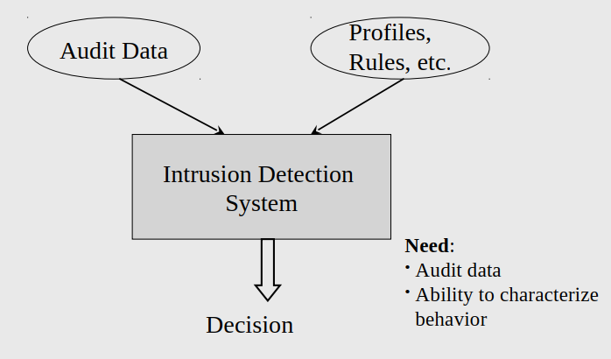
Audit-Based Intrusion Detection

Slide 16
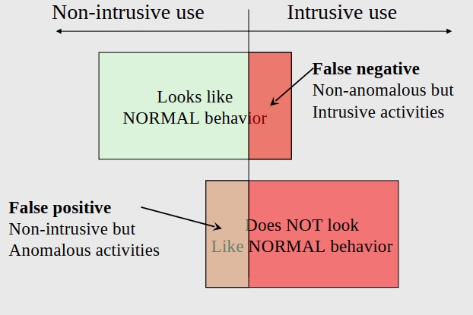
Anomaly versus Misuse

Slide 17
False Positive v.s. False Negative
False positive: non-intrusive but anomalous activity
■ Security policy is not violated
■ Cause unnecessary interruption
■ May cause users to become unsatisfied
False negative: non-anomalous but intrusive activity
■ Security policy is violated
■ Undetected intrusion

Slide 18
Intrusion Detection Techniques
Anomaly Detection
Misuse Detection
Hybrid Misuse/Anomaly Detection
Immune System Based IDS

Slide 19
Rules and Profiles
Statistical techniques:
■ Collect usage data to statistically analyze data
■ Good for both anomaly-based and misuse-based detection:
  Anomaly-based: standards for normal behavior. Warning when
  deviation is detected
  • Misuse-based: standards for misuse. Warning when phases of an
  identified attack are detected
  Threshold detection
  • E.g., number of failed logins, number of accesses to resources,
  size of downloaded files, etc.

Slide 20
Rules and Profiles cont.
Rule-based techniques:
  Define rules to describe normal behavior or
  known attacks
  Good for both anomaly-based and misuse-based
  detection:
  • Anomaly-based: looks for deviations from previous usage
  • Misuse-based: define rules to represent known attacks

Slide 21
1. Anomaly Detection Techniques
Assume that all intrusive activities are necessarily anomalous → flag all system
states that very from a “normal activity profile”

Slide 22
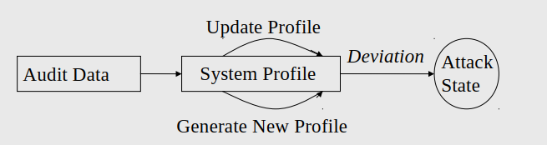
Anomaly Detection Techniques cont.
Need:
  Selection of features to monitor
  Good threshold levels to prevent false-positives
  and false-negatives
  Efficient method for keeping track and updating
  system profile metrics

Slide 23
2. Misuse Detection Techniques
Represent attacks in the form of pattern or a signature (variations of same attack can be detected)
Problem!
Cannot represent new attacks

Slide 24
3. Hybrid Misuse / Anomaly Detection
Anomaly and misuse detection approaches together
  Example:
  1. Browsing using TOR is not misuse but
  might be anomalous
  2. Administrator accessing sensitive files is not
  anomalous but might be misuse

Slide 25
4.Immune System Based ID
Detect intrusions by identifying suspicious changes in system-wide activities.
System health factors:
■ Performance
■ Use of system resources
Need: identify system-wide measurements

Slide 26
4. Immune System Based ID cont.
Principal features of human immune system that
are relevant to construct robust computer systems:
1. Multi-layered protection
2. Distributed detection
3. Diversity of detection
4. Inexact matching ability
5. Detection of unseen attacks

Slide 27
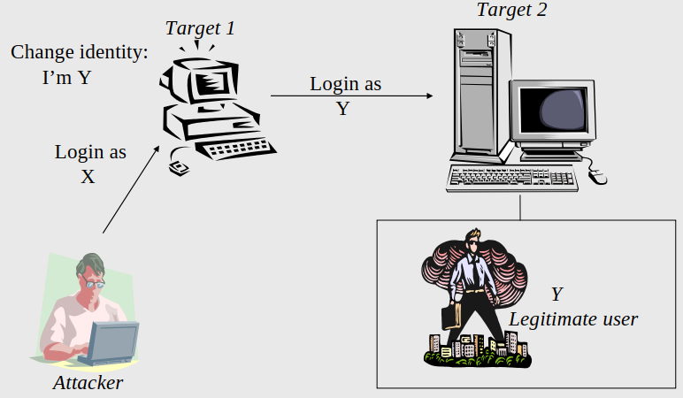
5. Masquerading

Slide 28
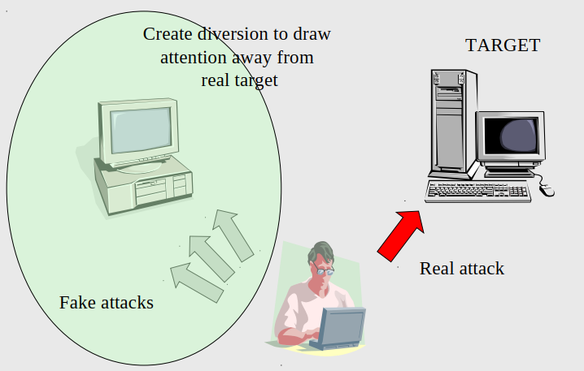
6. Diversionary Attack

Slide 29
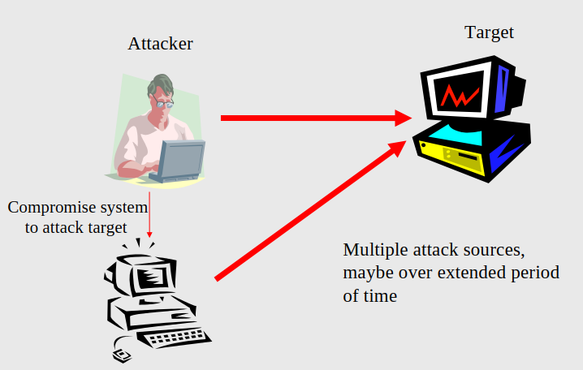
7. Coordinated attacks

Slide 30
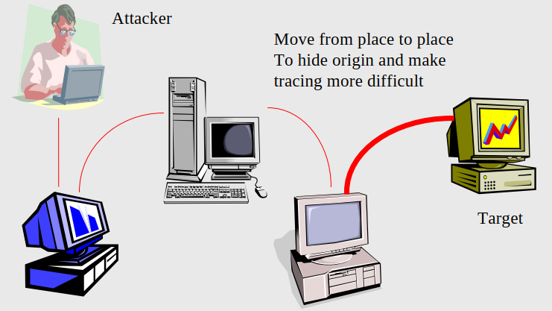
8. Chaining

Slide 31
Intrusion Recovery
Actions to avoid further loss from intrusion.
Terminate intrusion and protect against reoccurrence.
Reconstructive methods based on:
  Time period of intrusion
  Changes made by legitimate users during the effected period
  Regular backups, audit trail based detection of effected
  components, semantic based recovery, minimal roll-back
  for recovery.

